Slide 1
Hardware-In-The-Loop Emulator For In-Vehicle Controller Area Networks
Changhong Li
Supervisor: Shreejith Shanker
Date 23/05/2024
Notes:
Good morning, everyone. The name of my project is Hardware-In-The-Loop Emulator For In-Vehicle Controller Area Networks.
My name is Changhong and supervised by professor shreejith

Slide 2
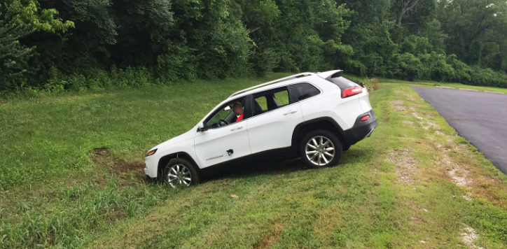
Background & Project goals
Problem Recap
Background
Project goals
In this project, we will build a hardware in the loop runtime for vehicular ECUs using a RISC-V / Microblaze softcore processor as the compute core for each ECU. We will integrate the ability to inject errors (like DoS, replay and spoofing) into the emulation framework with multiple ECUs spread across one or more FPGA development boards.
Hackers Remotely Kill a Jeep on the Highway (2015 USA)
Increased
Network
Complexity
Increased
Cyber Security
Risk
A hardware-in-the-loop emulator
for vehicle bus attack simulation & prevention
Hacker exposed the security vulnerabilities in automobiles by hacking into cars remotely, controlling the cars' various controls from the radio volume to the brakes on Wednesday, July 1, 2015 in Ladue
Notes:
First, let's review the background and goals of the project.
From this picture, we can see that this is a vehicle killed on the highway by the hackers, and this was really happened in 2015.
Nowadays, the vehicles are getting more and more intelligent which means the complexity of the network is also increasing, and this will finally lead to the increased communication security risk for the vehicle.
The goal of our project is to build a hardware-in-the-loop simulator for simulating and preventing vehicle bus attacks

Slide 3
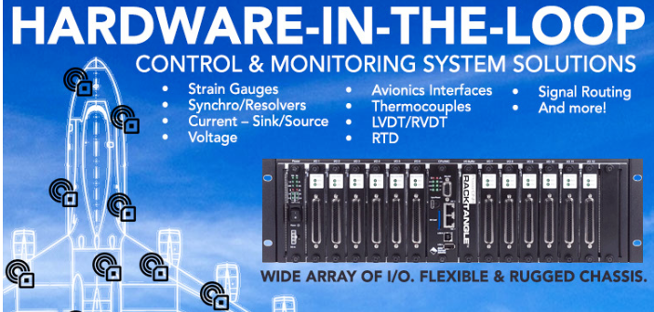
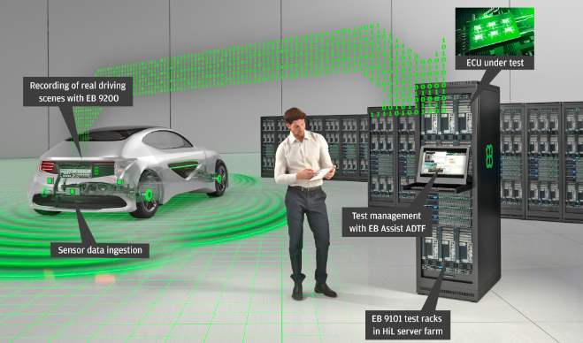
Previous work & Novelty
Previous work - HWIL
Hardware-in-the-loop simulation was first used in the 1960s in the aerospace field, it was used to test flight control systems, and now it is also widely used in the automotive field.[1]
The applications in the automotive field, HIL provides a virtual vehicle for system-level verification.
Virtual ECU technology is a hot topic
[1] S Raman, N Sivashankar, W Milam, W Stuart, and S Nabi. Design and implementation of hil simulators for powertrain control system software development. In Proceedings of the 1999 American Control Conference (Cat. No. 99CH36251), volume 1, pages 709–713. IEEE, 1999
Notes:
The concept of Hardware-in-the-loop simulation was first proposed in the aerospace field in 1960,
and is now widely used in the automotive simulation field for system-level verification.
The development of technology of virtual ECU is still proceeding

Slide 4
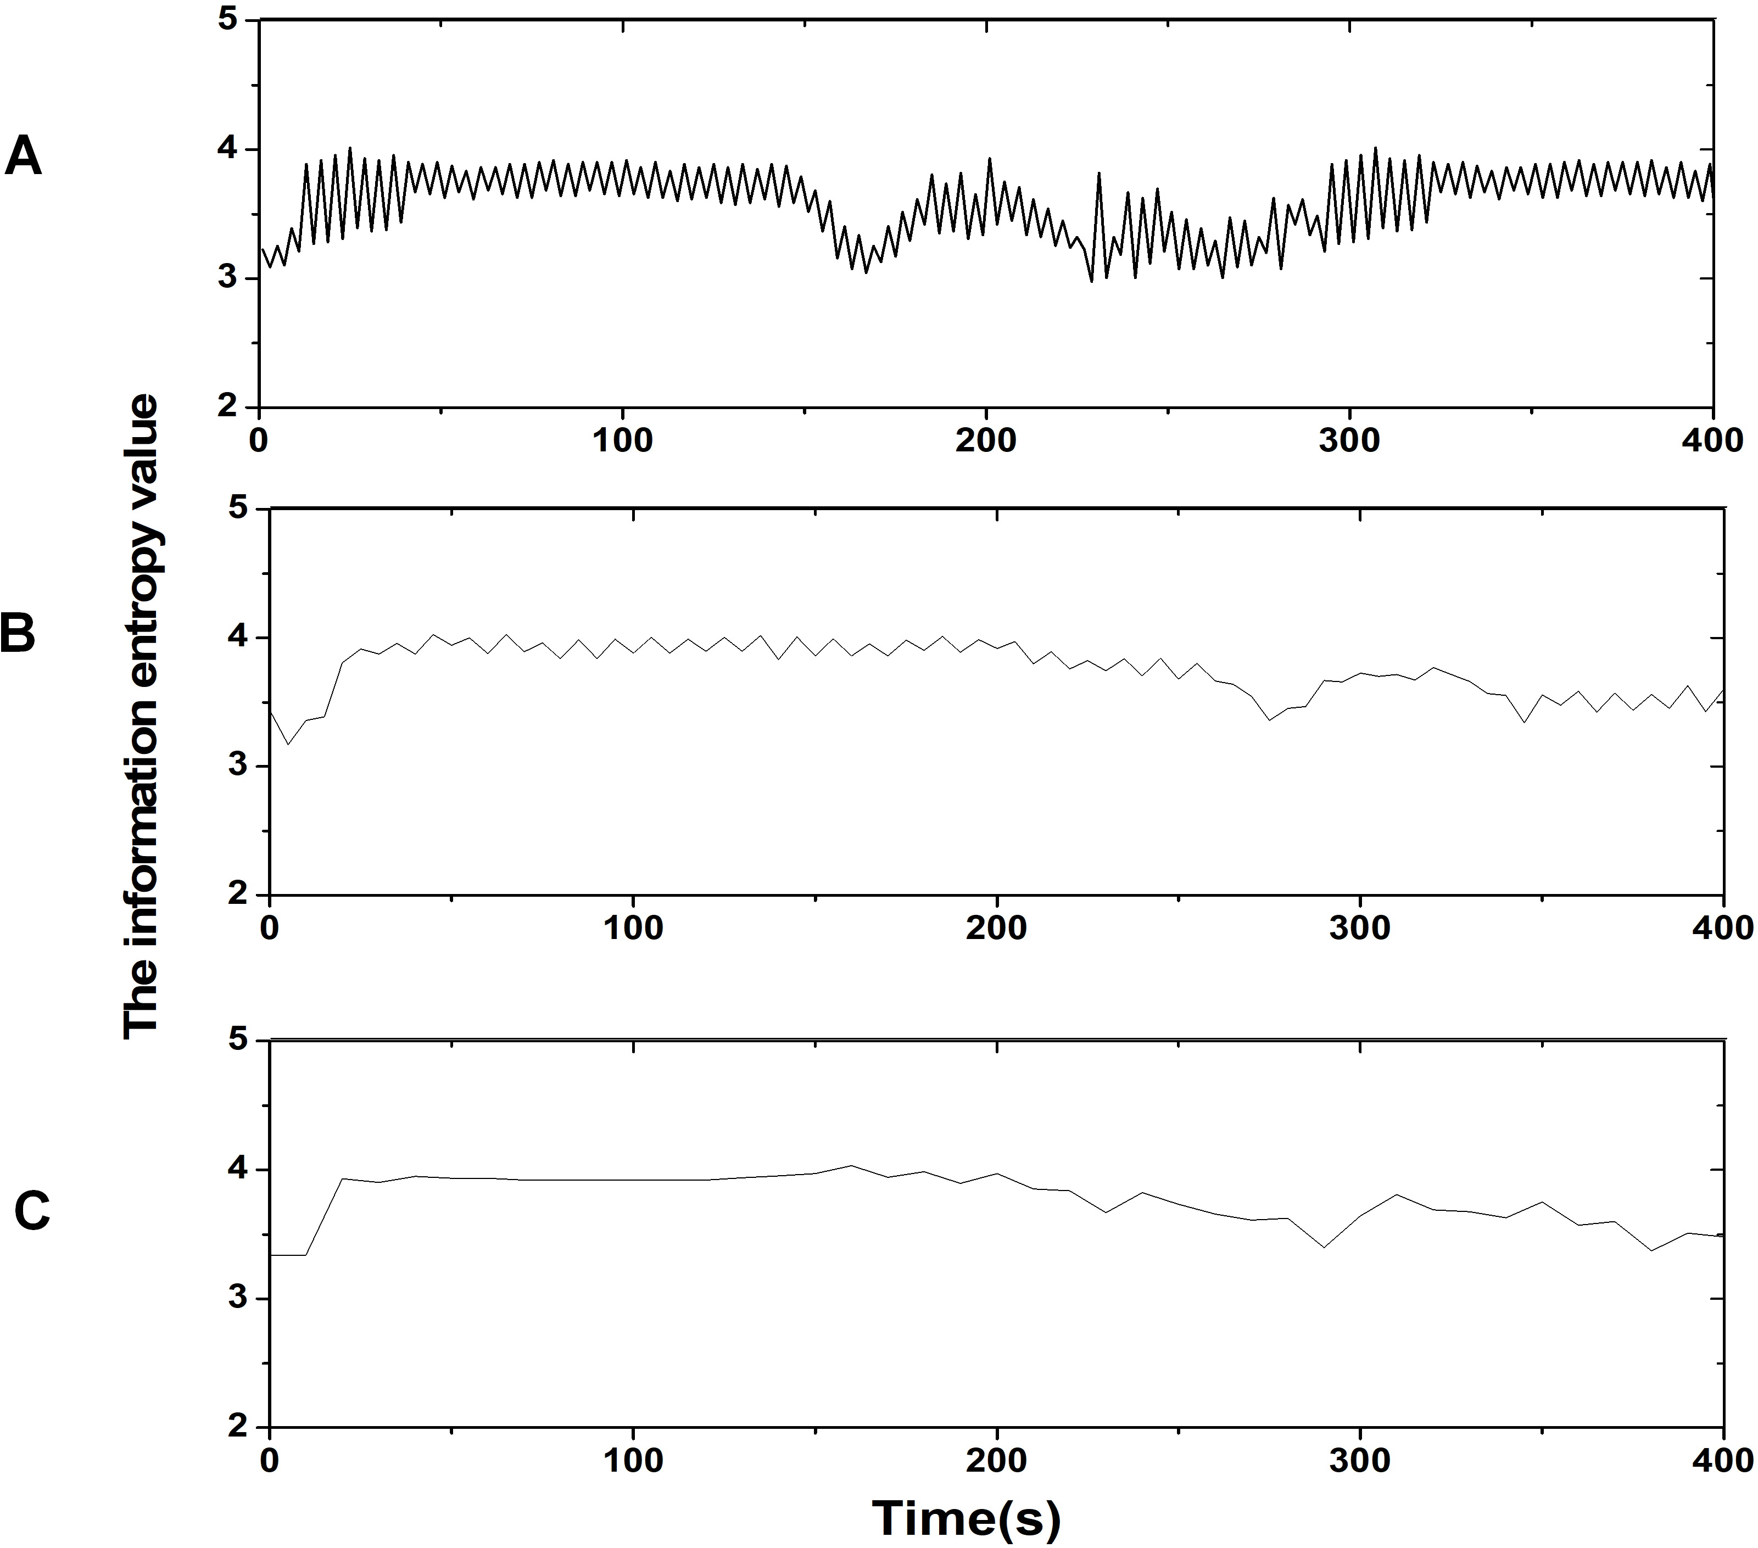
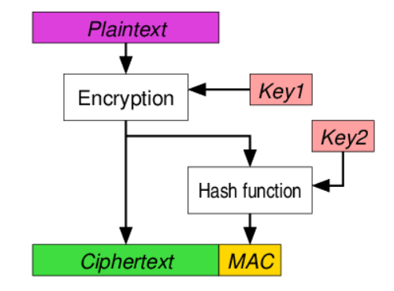
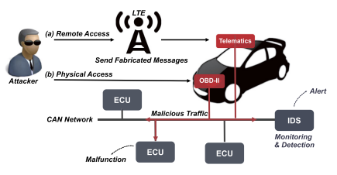
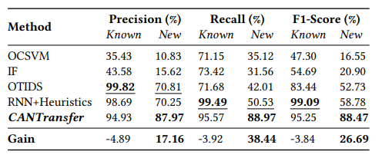
Previous work & Novelty
Previous work – attack detection
Traditional Detection & Encryption
IDS & DNN detection
Neural networks have greatly improved attack detection performance,
But how to deal with flexible system ( Topo change -> Feature change)
Agile attack simulation & model building toolchain
to be developed
Notes:
In the process of preventing in-vehicle network attacks, researchers in the field have made a lot of efforts, including entropy-based detection, data encryption, and the use of IDS and DNN.
DNN has greatly improved the attack detection performance, but with changes in network structure, its data model will also change to a certain extent to achieve the desired performance.
So how do we deal with this situation? We need an agile attack simulation and model building tool chain

Slide 5
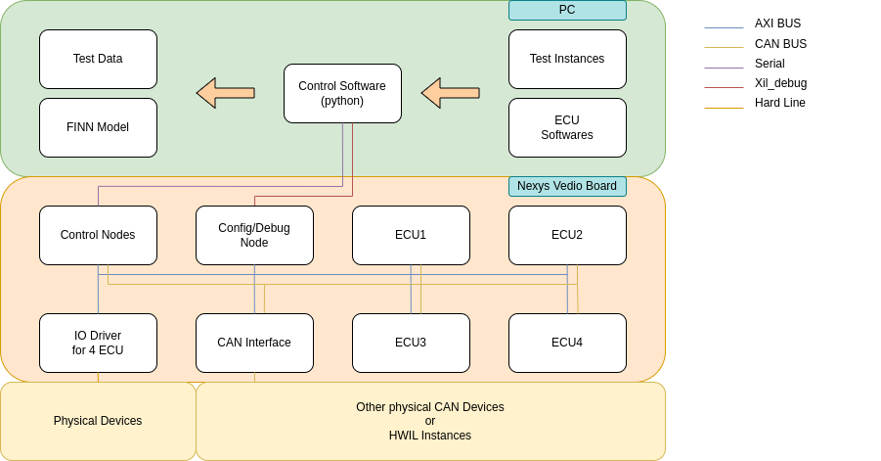
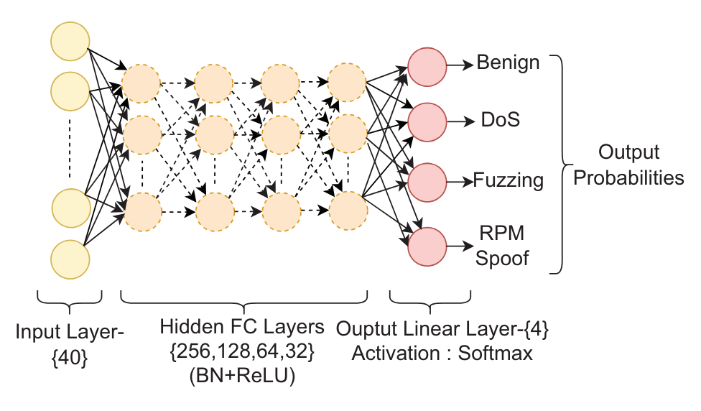
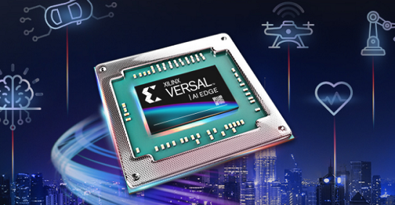


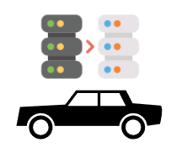
Progress Review
Project Structure
Flexible
HWIL Emulator
High-Performance
QNN Accelerators
Deployable
Stitched IP for Edge
Flexibly Changeable System Structure
Complete CAN bus
Test & Detection Solution
Empower
Automotive Safety
Notes:
When the system structure changes, we use a flexible simulator to build a CAN bus network and perform communication and attack simulations to obtain the latest bus feature data.
We can then quantify the model, form a stitched IP and deploy it to the vehicle.
By this tool chain, we can empower automotive safety through a complete attack test and detection solution.

Slide 6
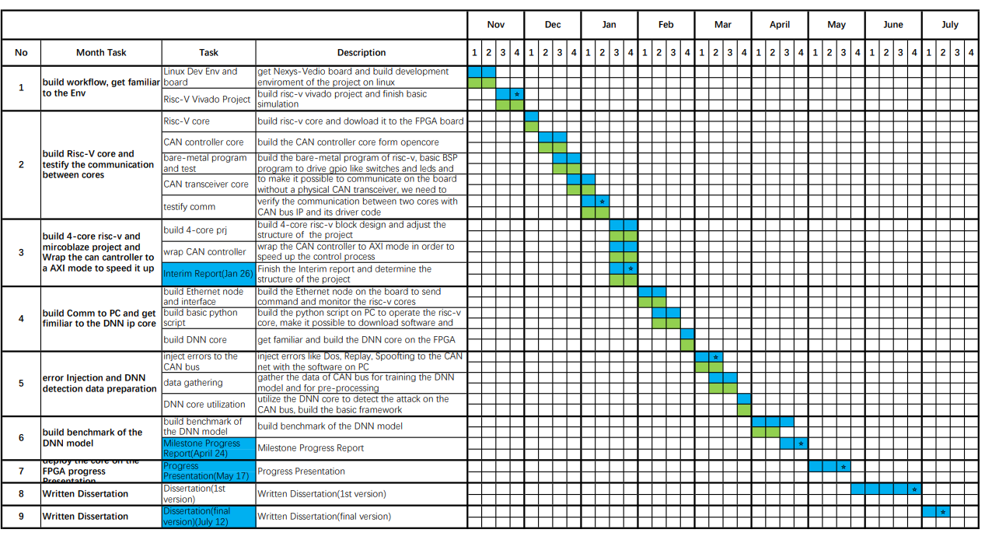
Progress Review
Milestone Review
Gantt Chart
Main goals
Virtual ECU cores & Control logic
Virtual CAN bus network
Attack Injections
Attack detection model
Hardware Accelerators
Benchmarking
Notes:
This is our project plan Gantt chart,
which includes ECU establishment, virtual vehicle network establishment, etc.
we will introduce some of the contents to review our progress

Slide 7
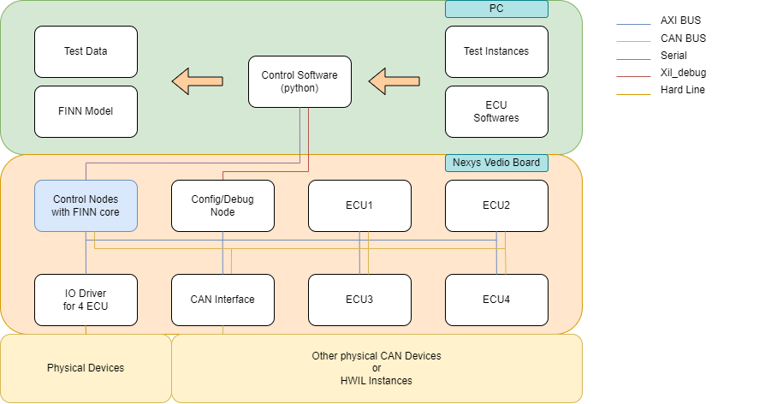
Progress Review
HWIL Emulator - Structure
Flexible nodes(type, scale)
Physical device access
Automatic testing
Complete tool chain
Network
Change
Test&Data
Model Deployment
Software
Define
Auto
Annotation
FINN
Tool chain
HWIL Emulator Structure
Accelerate Deployment
Notes:
For our emulator, we have a three-layer structure: control software layer for testing, the hardware layer for virtual networks, and other external device layers.
From topology changes to data annotation to model deployment, accelerate the development process

Slide 8
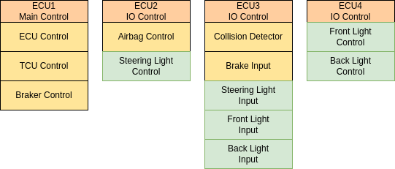
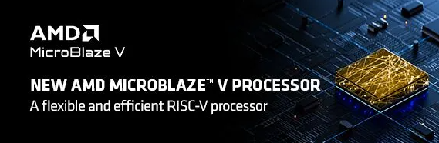
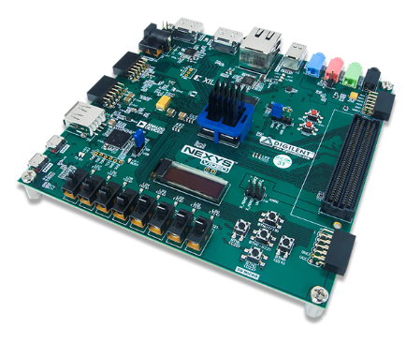
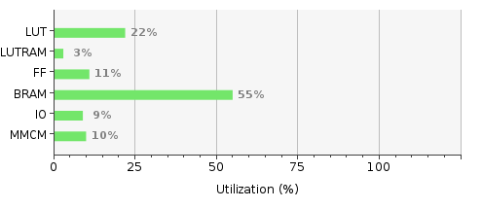
Progress Review
Virtual ECUs
Simulating CAN bus topology
Soft MCU Core: AMD Microblaze
Hardware Implementation Platform
Effective Resource Utilization - Scalable
Notes:
On the virtual ECU, we built a simple 4ECU topology and used Microblaze to build the virtual ECU program on the Nexys platform.
We can see that our resource usage is advantageous, which means that we are more scalable in terms of the number of ECUs.

Slide 9
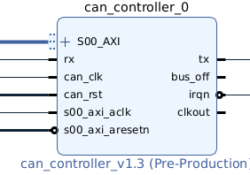
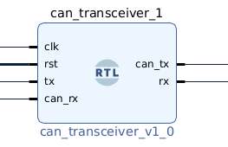
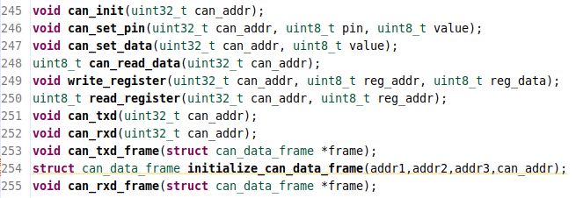
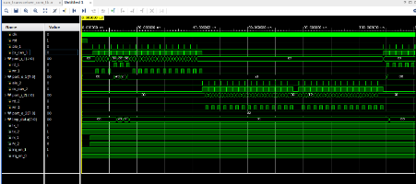
Progress Review
Virtual CAN BUS network
AXI CAN controller IP core
CAN transceiver IP core
Standard driver
IP core timing simulation
Notes:
In establishing the CAN bus network, we avoided using paid controller IP and signal processing IP,
but instead used open source code and reconstructed its interface, wrote a standard driver for its IP core, and performed timing simulation on it.

Slide 10
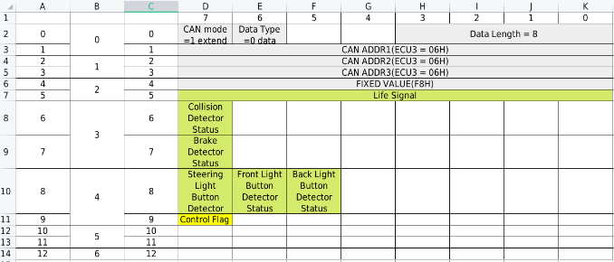
Progress Review
Virtual ECU control logic
Virtual communication protocol
Build up 4 ECUs with different logic for the test.
All ECUs: Generate Life signal to indicate that they are alive. periodically send status messages to report their status.
ECU1: Control Engines, transmission unit and brake unit.
ECU2: Control Airbags and Steering Lights.
ECU3: Physical IO inputs, receive the signal from the sensors like Collision detector, brake detector, Lights control switches
ECU4: Control Front light and back light of the car.
All the ECUs communicate with CAN bus.
Building a virtual communication protocol And build ECU collaborative applications
Notes:
The communication network we simulated has 4 ECUs, each of which has some basic signals such as life signals
and other input and output signals for control, such as electronic control of brakes and turn signals
We developed a communication protocol for its communication and wrote logic control programs for these ECUs
Through external hardware interaction, some basic control applications can be simulated

Slide 11
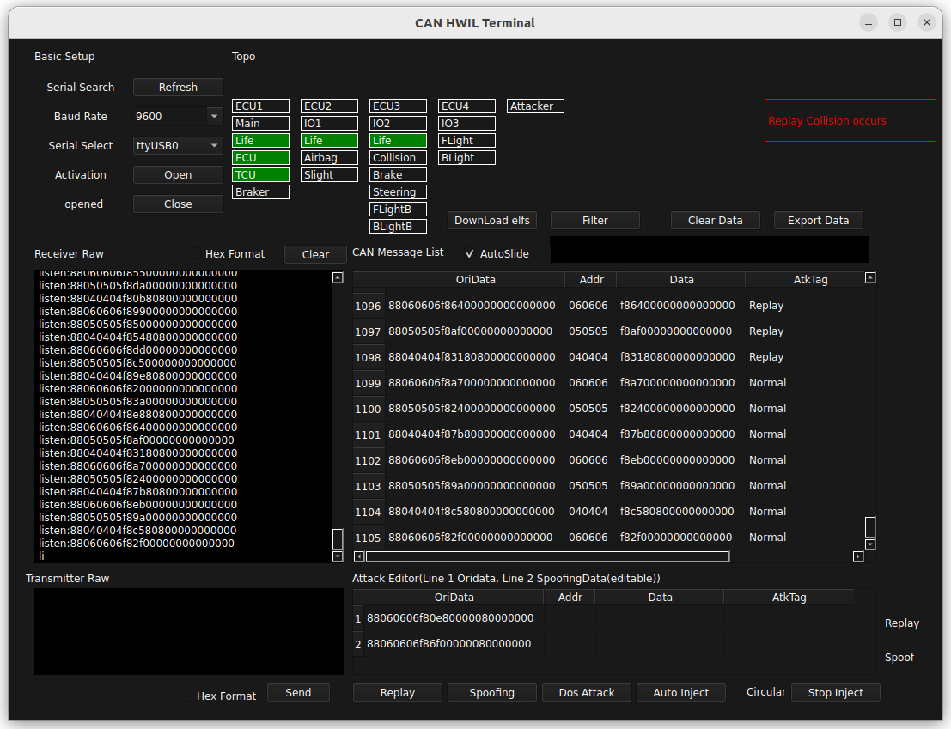
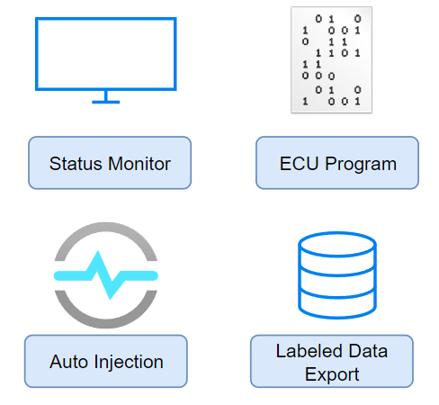
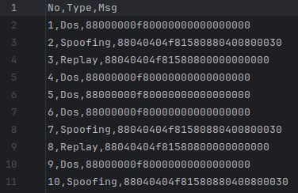
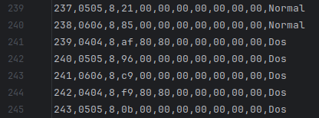
Progress Review
ECU Attack Test Platform
Labeled data
for training
Attack
Sequence
Notes:
This is the interface of our attack test platform.
The platform has four main functions.
The first function is monitoring. By connecting it to our FPGA, we can monitor the messages on the CAN bus in real time and analyze the status of the actuators controlled by each ECU.
The second function is the ECU program download function. Without using a complex tool chain, you can quickly change its application control program and start testing by simply updating the ELF file.
We can describe the attack vector in a standard form and store it in a data set, which will be loaded and automatically tested by our platform.
At the same time, for our test results, the platform will automatically mark the data in the attack time period as attack data and describe its attack type. After the test is completed, it can be exported as a data set for direct model training.
I used to be a train network control engineer, and I referred to my previous experience in the design of the communication protocol and tool chain.

Slide 12
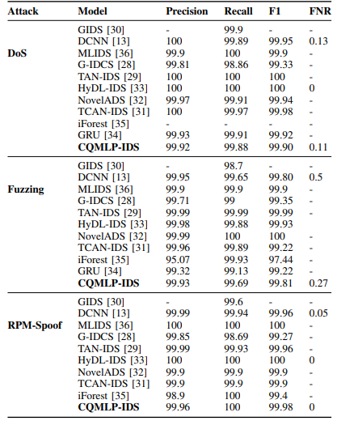
Progress Review
Model and performance
Successive
CAN Message
(ID + Payload)
Mature
Flexible & Deployable & High-performance
CAN bus Attack detection model [1]
[1] Shashwat Khandelwal and Shanker Shreejith. Exploring highly quantised neural networks for intrusion detection in automotive can. In 2023 33rd International Conference on Field-Programmable Logic and Applications (FPL), pages 235–241. IEEE, 2023
Notes:
In terms of attack detection, we refer to Dr. Shashwat's MLP model because the model has been well verified in terms of performance.
We use four consecutive messages as input and classify the message types.
The performance of this model is excellent in all parameters.
In the existing research, we have performed performance analysis on the composition and quantization level of input features.
Finally, we decided to use 2-bit quantization and input features composed of ID and payload.

Slide 13
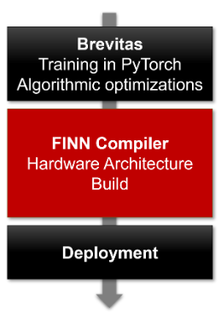
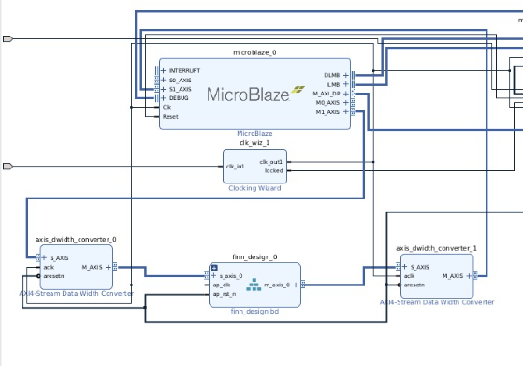
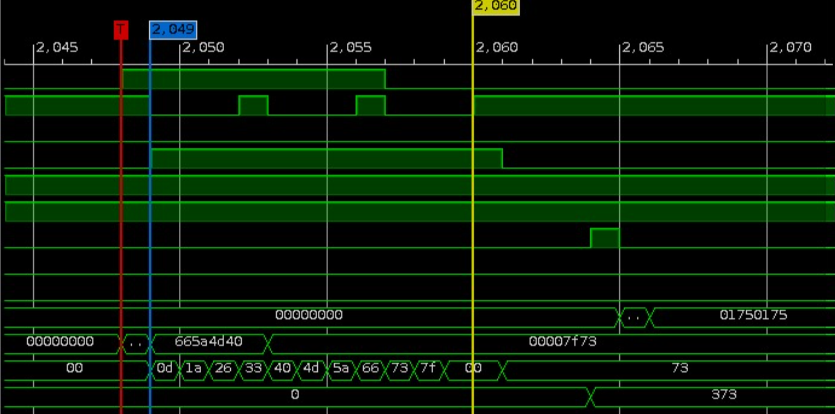
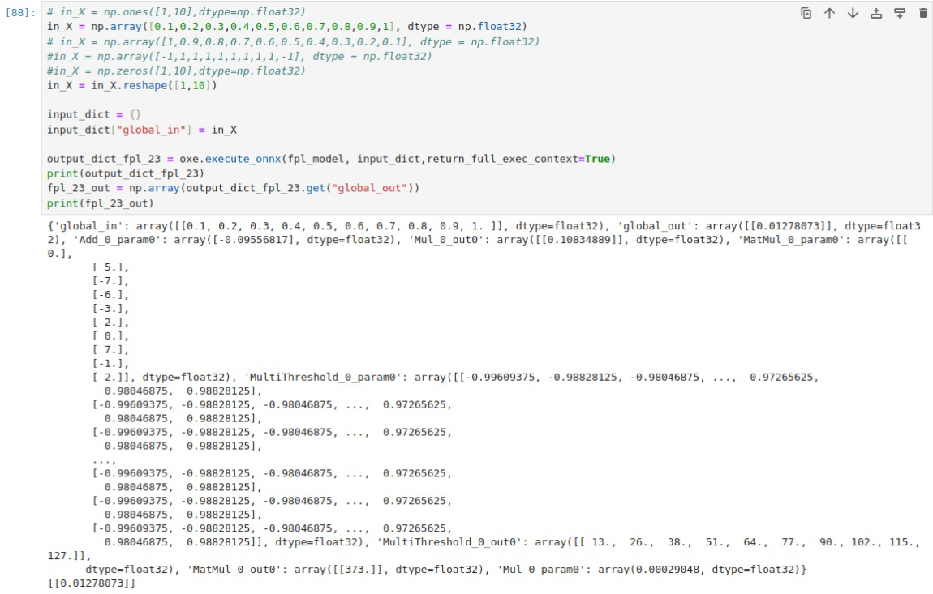
Progress Review
Model integration and testing
FINN Flow for light-weight platforms
Microblaze calls FINN IP via AXI-Stream
Model data ILA capture
Compare SW model with HW model
Notes:
By using the Brevitas framework, we quantized the model and sent it to the FINN workflow to obtain a stitched IP that can be deployed on a lightweight platform.
This is different from the existing standard workflow, which can only be deployed on platforms such as ZYNQ.
After obtaining the stitched IP, we used microblaze to use AXI Stream to input bus data and obtain model output results.
We used ILA to monitor the model running data on the FPGA and compare the results of the model running on the computer for consistency comparison.

Slide 14
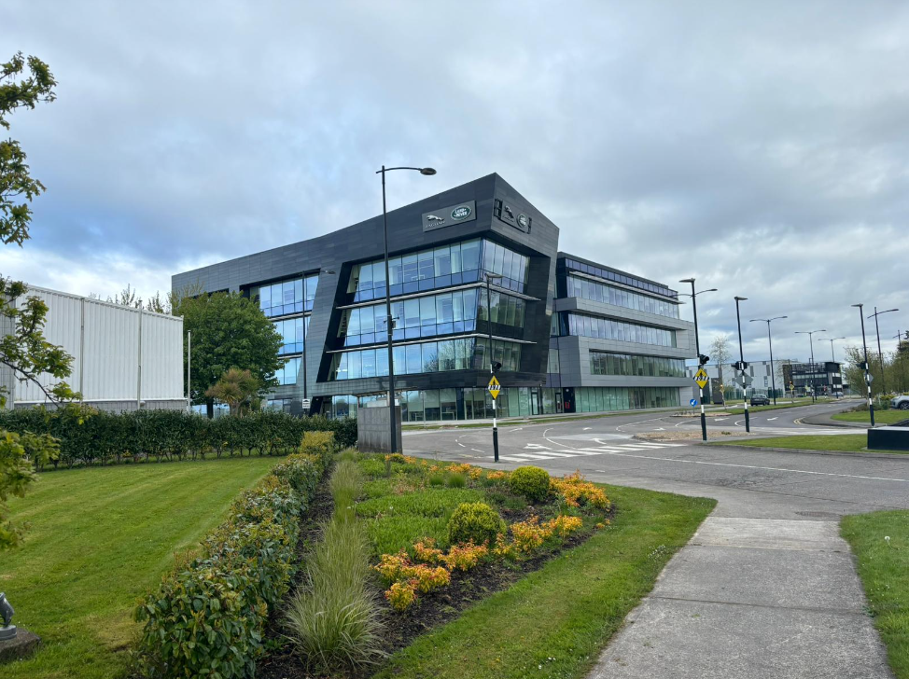
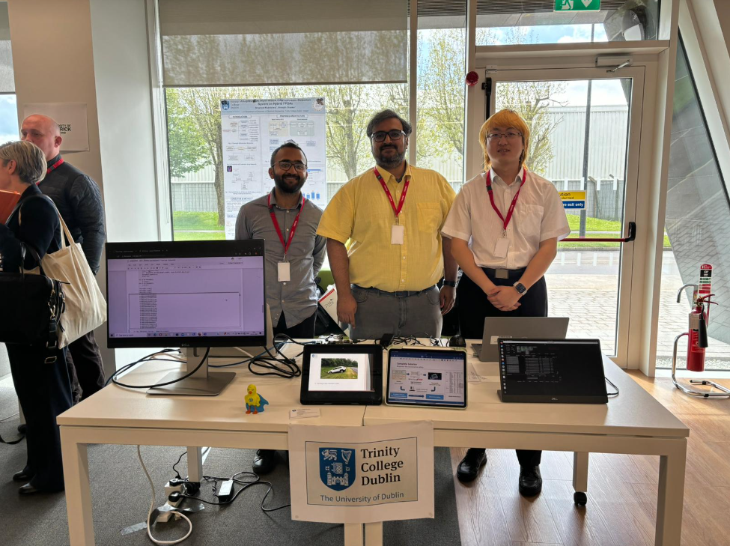
Progress Review
JLR Testing Tech Week - Share Fair
Participate in Jaguar Land Rover testing technology sharing fair and demonstrated the project
Notes:
Earlier this month, we also shared and demonstrated our project at the JLR Test Technology share fair in Limerick.

Slide 15
Progress Review
Milestone modification
Original plan: Using Risc-V rocket soft core simulation ECU
Plan after the change: Using Microblaze as ECU soft core
Reason for change: Microblaze is more suitable for Xilinx ecosystem, which is convenient for debugging and driver coding. Microblaze is gradually beginning to support Risc-V instruction set.
Original plan: Adopt the standard FINN integrated flow integrated attack detection core
Plan after the change: Slightly behind schedule with custom build flows that can target both lightweight and traditional FPGAs
Reason for change: Makes the project more versatile, but the custom workflow is slightly more complicated than the standard integration process
Functions such as automated attack injection, data export, and attack detection IP core hardware deployment were not originally planned, but were added for engineering integrity and usability.
Notes:
For milestone nodes, we have some changes that need to be explained.
The first change is to replace the core of the analog ECU from the Risc-v rocket core to the microblaze core, which is easier to debug and the latest microblaze core begins to support the risc-v architecture.
The second change is to use the standard FINN integration flow to obtain the stitching IP, but this is not valid for non-ZYNQ platforms. We use a custom workflow instead, which makes the progress of this part a little delayed, but it also makes it more adaptable.
At the same time, some functions such as automated testing and data export were not in the previous plan. After completing the established goals, we added these capabilities to improve its engineering usability.

Slide 16
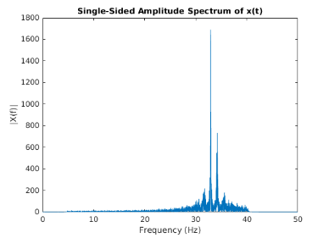
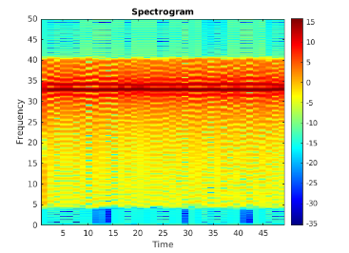
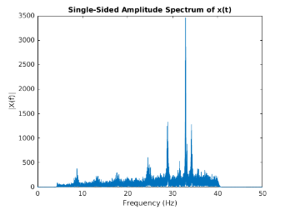
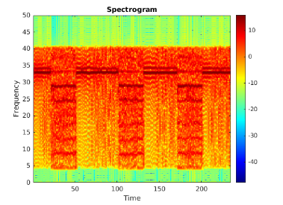
Plan for the rest of the project
Next step
Performance optimization
Resource utilization optimization
Ablation experiment
Quantization effect
Acceleration test
Model benchmarking and optimizing
Testing and comparison of other methods
(like using STFT with DNN for attack detection)
Of course, there is also thesis writing, refer to the previous Gantt chart plan
Notes:
In the next period of time, we will consider testing and optimizing the performance of the system, including model analysis, resource usage analysis, and performance analysis.
At the same time, we will also study some other attack detection methods, such as using the STFT method.
In this picture, we can see the changes in bus characteristics under DOS attacks. Of course, there is also writing papers.

Slide 17
Thank You
Changhong Li
Supervisor: Shreejith Shanker
Date 23/05/2024

